Slide 1




Early Heart Attack Care of the ACS Patient
Annual Education
Choose Mon Health. Feel The Difference.

Slide 2
Early Heart Attack Care (EHAC) is a program at
Mon Health to assist the staff in prompt recognition and treatment of our patients who may be showing early warning signs and symptoms of possible acute coronary syndromes (ACS).
Goals:
Deliver prompt high quality cardiac care to those patients who may be experiencing possible Acute Coronary Syndromes.
To help the patient recover and maintain a healthy cardiac lifestyle.
To be a resource to the staff and patients in the care of cardiac related disease/illness.
Review of the most current AHA standards in the care of the Acute Coronary Syndrome (ACS) patient.
Review of Order sets, risk stratification and documentation for all levels of care and transition of the cardiac patient.
Choose Mon Health. Feel The Difference.

Slide 3

Risk Stratification
Stratification of patient assures that the ACS patient receives the appropriate care
Admitted to the appropriate floor
Alerts the medical staff of the probability of a potential future cardiac related event.
Should occur with any change in patient condition and be used as a guide for transition of care.
Two forms of Risk Stratification are used at MHMC:
  HEART score in Emergency Department for admission purposes/consults.
  TIMI score on ALL admissions/ intra-facility transfers and direct admissions.
Choose Mon Health. Feel The Difference.

Slide 4
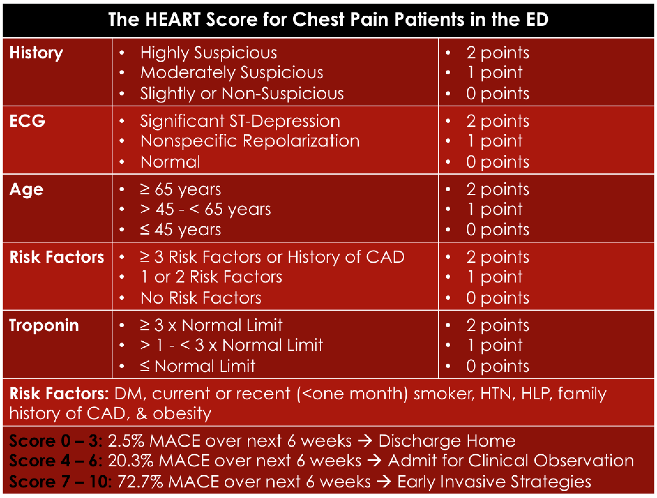
Risk Stratification HEART
Choose Mon Health. Feel The Difference.

Slide 5
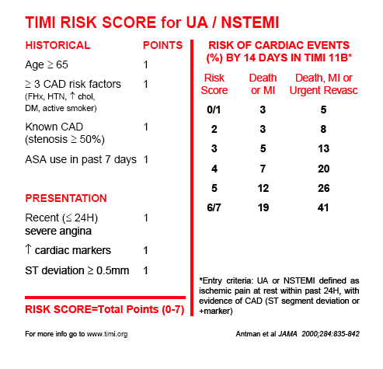
Risk Stratification TIMI
Choose Mon Health. Feel The Difference.

Slide 6
EKG’s
The clock starts with onset of symptoms.
The staff are being instructed to obtain an EKG within 10 minutes of ACUTE onset of symptoms.
The staff are also instructed to activate RAPID RESPONSE.
EKG should be read promptly, and risk stratification occur. This is required if the patient is admitted to a non-cardiac floor and develops symptoms.
Choose Mon Health. Feel The Difference.

Slide 7
EKG Serialization
Order set for EKG’s
EKG at baseline or ‘time zero’
Repeat EKG 3 hours after baseline or ‘time zero’
Choose Mon Health. Feel The Difference.

Slide 8
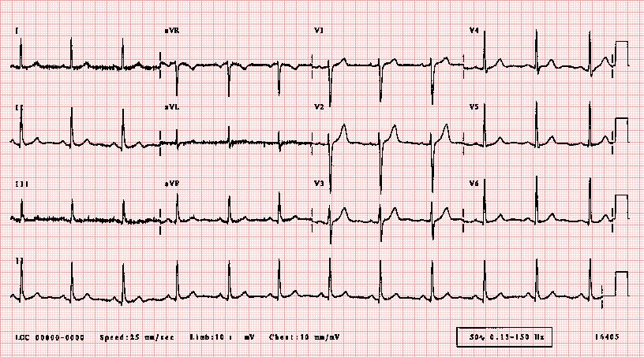
“Normal EKG”
Choose Mon Health. Feel The Difference.

Slide 9
Treatment Plans
Patient on NON-CARDIAC floor?:
  Risk stratify with TIMI
  Treatment with Nitroglycerin, Aspirin, Beta-blocker, and heparin as appropriate (start chest pain order set).
  Upgrade level of care to SDU or ICU as appropriate.
  Consult Cardiology ASAP, if not already involved in the care of the patient.
Choose Mon Health. Feel The Difference.

Slide 10
Treatment Plans
Patient on CARDIAC floor?:
  Risk stratify with TIMI
  Treatment with Nitroglycerin, Aspirin, Beta-blocker, and heparin as appropriate (start chest pain order set).
  Upgrade level of care to CCU or ICU as appropriate.
  Notify Cardiology ASAP!
Choose Mon Health. Feel The Difference.

Slide 11
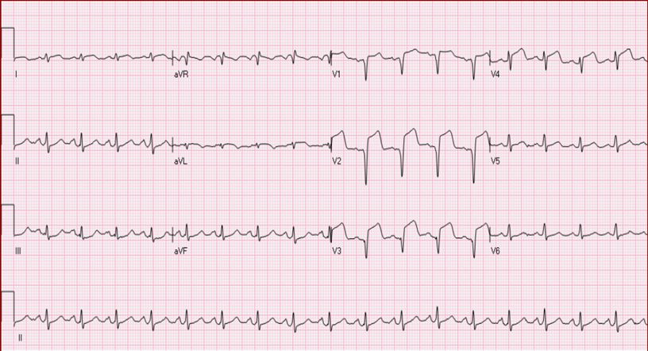
STEMI
Choose Mon Health. Feel The Difference.

Slide 12
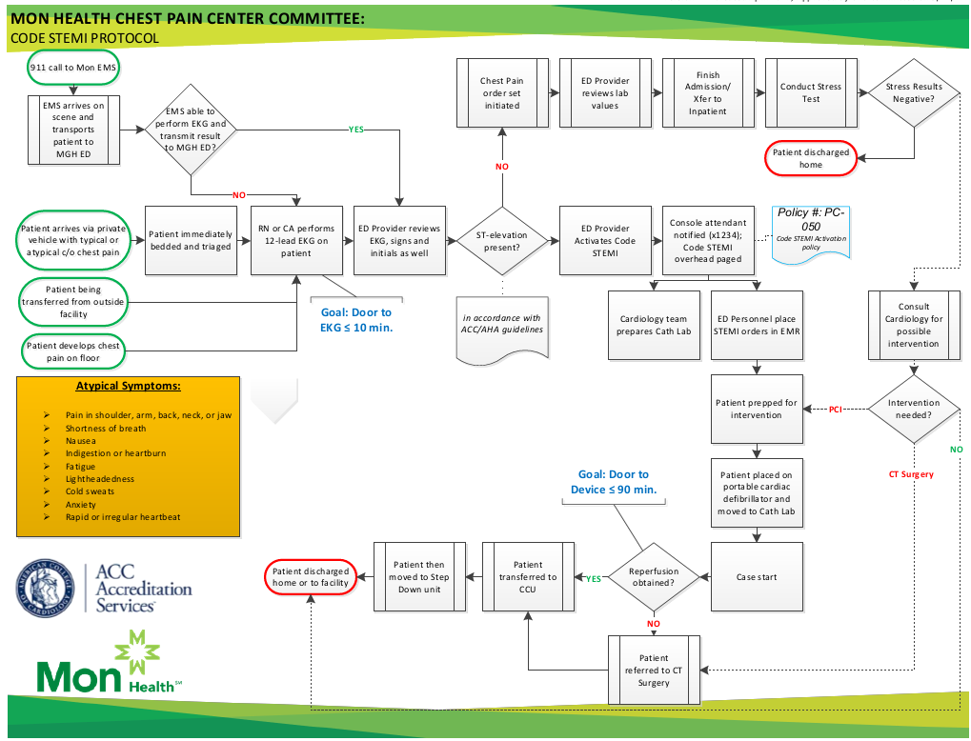
Choose Mon Health. Feel The Difference.

Slide 13
Treatment Plan
Regardless of location:
  CODE STEMI paged
  Activation of STEMI ED order set
  ASA, NTG, Beta-blocker and Anti-coagulation per Cardiology
  Morphine/Fentanyl for pain
  Prep for Cath
    Bilateral Groins need to be clipped free from hair and RIGHT wrist
If for any reason, the procedure may be delayed, consider thrombolytic therapy AFTER conversation with Cardiologist.
Choose Mon Health. Feel The Difference.

Slide 14
Cardiac Biomarkers
Elevation of biomarkers (enzymes) may not occur during the early stages of a heart attack. So, biomarkers are ordered as a serial set.
Time ‘zero’ – The first set of enzymes obtained on the patient. Usually completed in the Emergency Department or upon arrival when directly admitted to the floor.
Choose Mon Health. Feel The Difference.

Slide 15
Biomarkers
Standardization of Lab Draws:
    3 hours and 6 hours from time ‘zero’ NOT from the time of admission to the floor/unit.
Example: ED Lab Draw at 1100 (time ‘zero’),
    3 hours at 1400
    6 hours at 1800
Choose Mon Health. Feel The Difference.

Slide 16
Stress Testing
Stress Testing will be ordered after serialization of biomarkers are negative
The physician may order an exercise graded stress or a nuclear stress test
Patients who show a ‘positive’ stress test are then sent for diagnostic angiography to determine the level of blockage.
Choose Mon Health. Feel The Difference.

Slide 17

Medication Reconciliation
  Aspirin
  Statin
  P2Y12
If yes
Did your patient receive a cardiac stent during their admission?
Choose Mon Health. Feel The Difference.

Slide 18
Who is responsible for making sure that the patient is discharged to home on appropriate therapy?
Patient
NP’s
PA’s
Nurses
Doctors
NCDR
18

Slide 19
Required Medications Upon Discharge
RX at DC | Aspirin | P2Y12 | Statin | Beta Blocker | ACE/ARB for LVSD (EF <40 %) | Aldosterone Antagonist for LVSD (EF <40%) | Cardiac Rehab Referral, Phase II
PCI Includes Balloon/Stent | ** |  | *
*High Intensity Statin includes: Atorvastatin 40-80 mg and Rosuvastatin 20-40 mg
** If Aspirin is not indicated – an order or note needs to be entered into patient’s chart indicating reason why (i.e., Aspirin, triple therapy not indicated, etc.)
19

Slide 20

Aspirin Prescribed?
  A – Aspirin
    Must appear on Discharge Rec
    If not, an order placed prior to discharging patients
A
S
P
Choose Mon Health. Feel The Difference.

Slide 21
Statin Prescribed?
  S – Statin
    Must appear on Discharge Rec
    If not, an order placed prior to discharging patients
A
S
P
Choose Mon Health. Feel The Difference.

Slide 22
P2Y12 Therapy Prescribed?
  P – P2Y12 – One of the following must be prescribed and appear on the Discharge Medication Reconciliation
A
S
P
P2Y12 drug choices:
Clopidogrel
Prasugrel
Ticagrelor
Ticlopidine
Choose Mon Health. Feel The Difference.

Slide 23
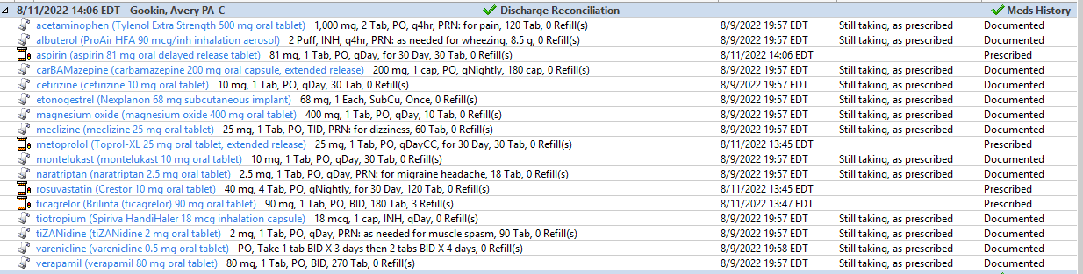
Has Medication Reconciliation been completed?
Choose Mon Health. Feel The Difference.

Slide 24



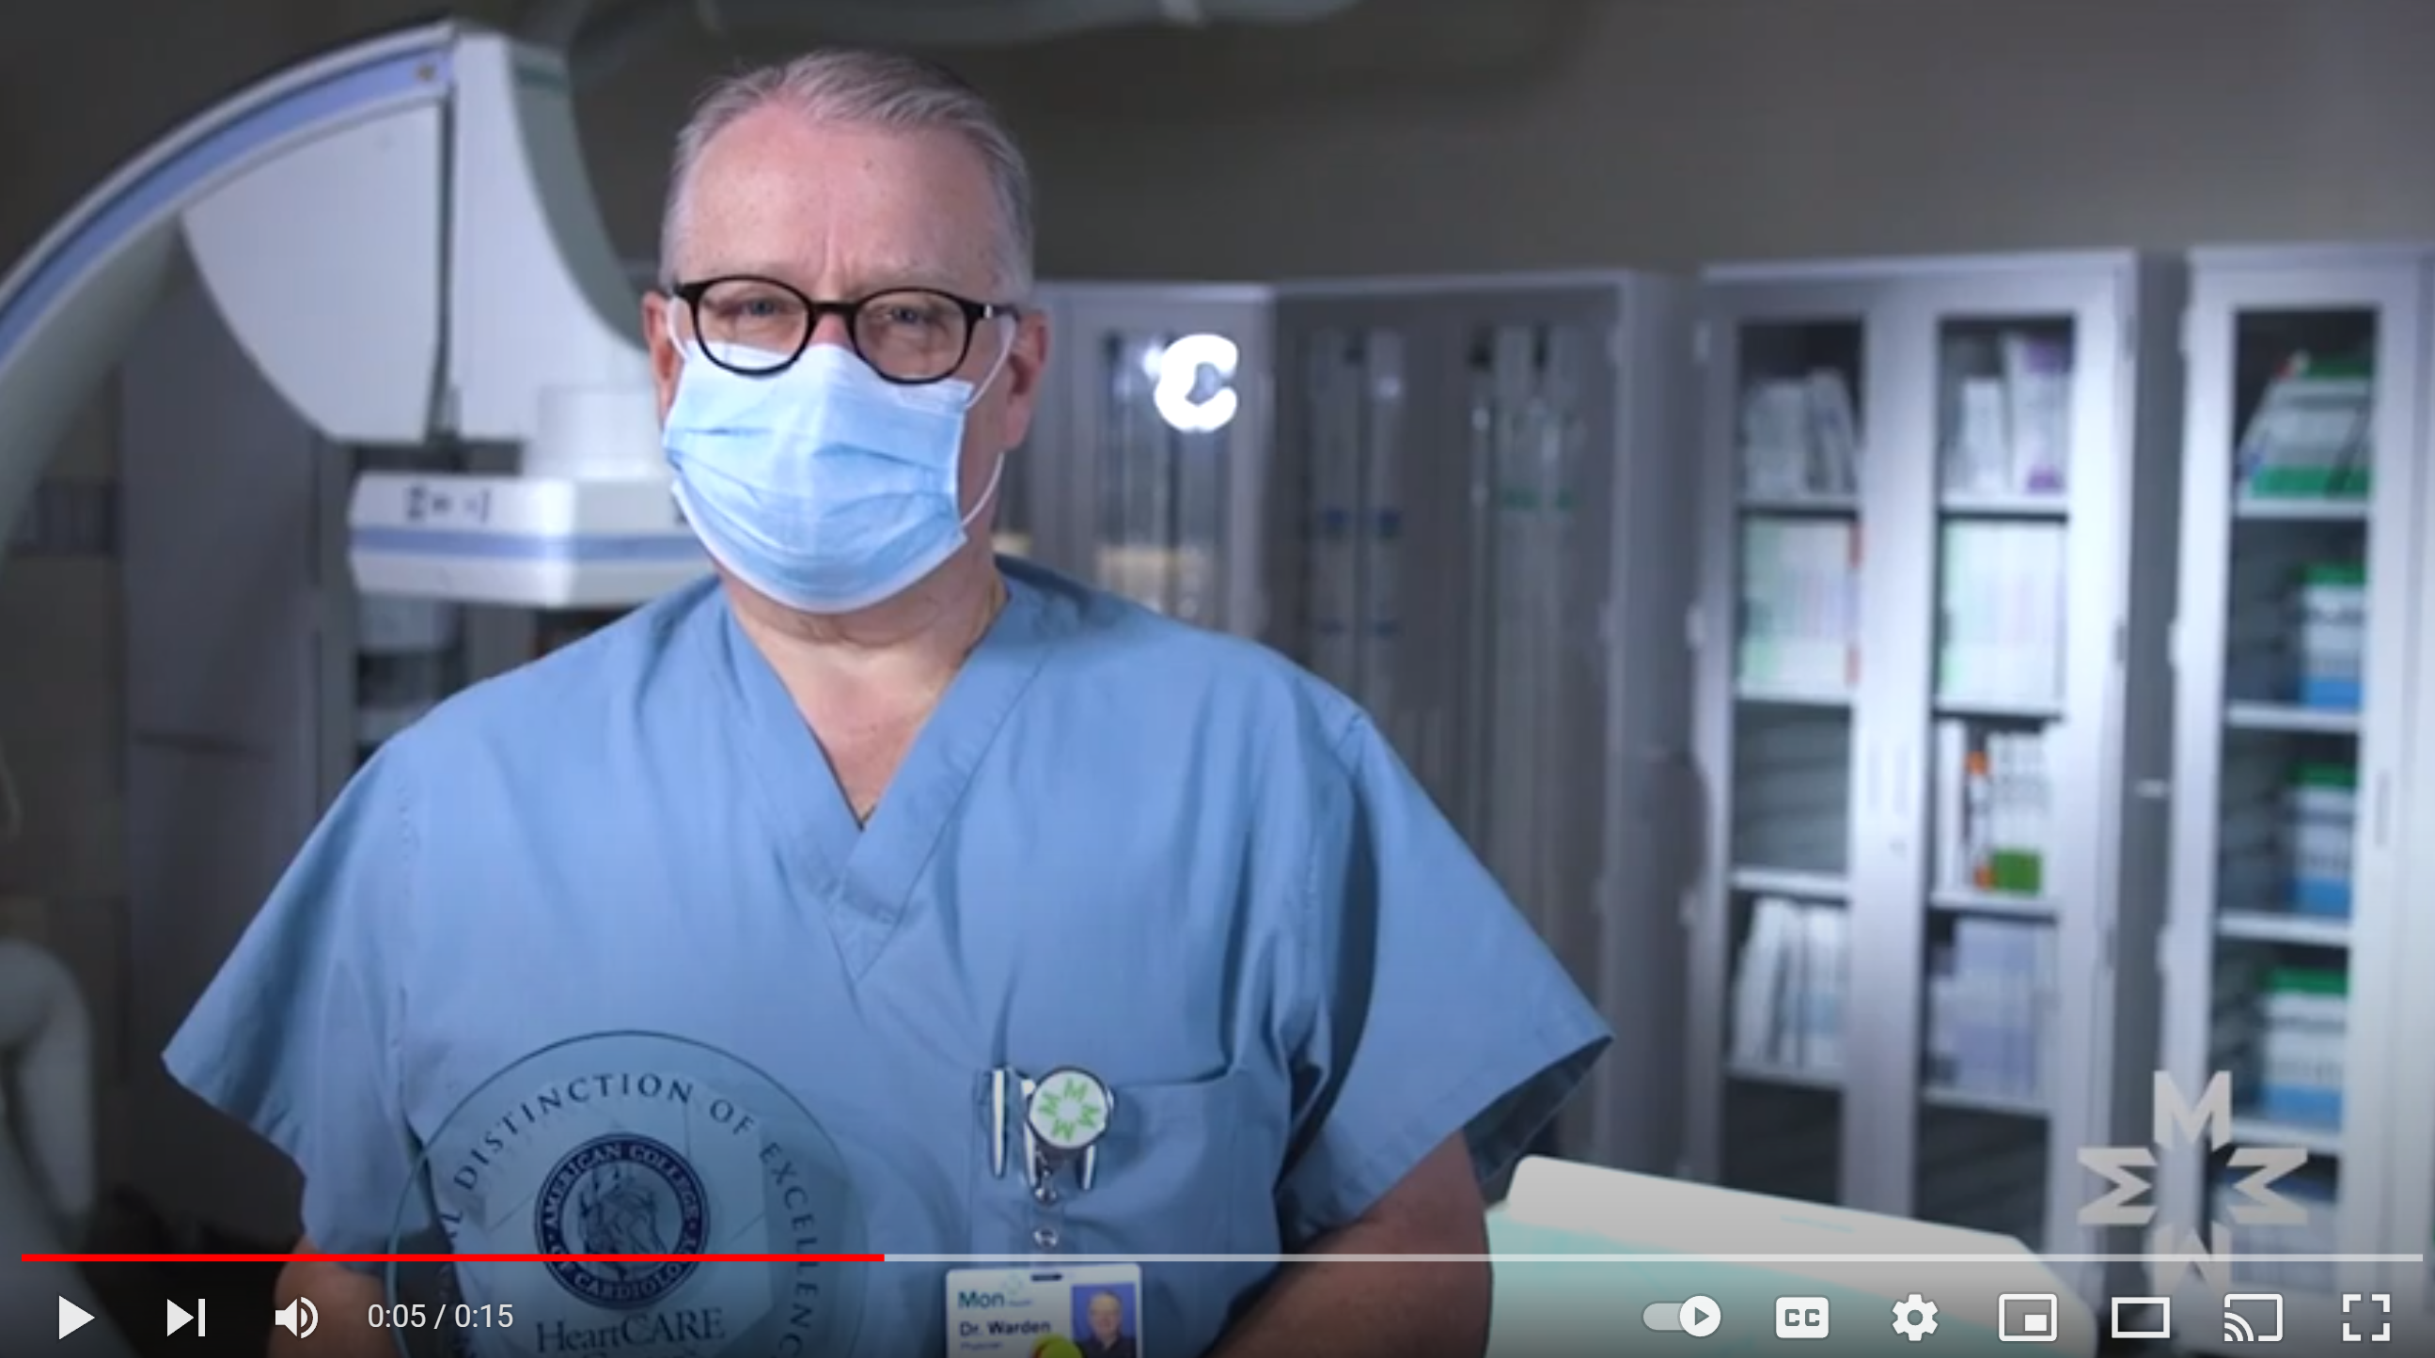
Mon Health Heart & Vascular Center

Slide 25

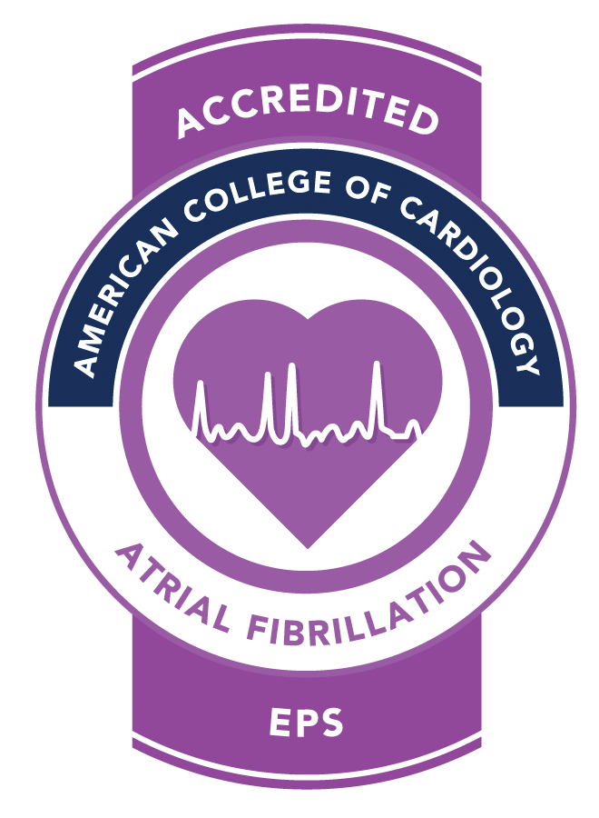
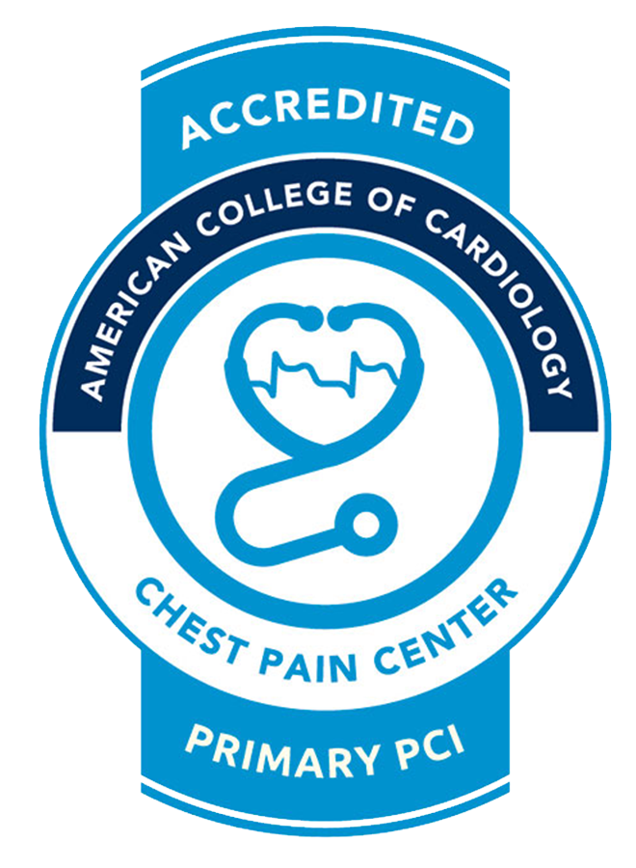

WV’s Leader in Heart Care
  Achieved ACC Atrial Fibrillation Electrophysiology Services Accreditation
  Achieved ACC HeartCARE Center National Distinction of Excellence
  Achieved ACC Chest Pain PCI Accreditation
  Invited to participate in an exclusive clinical trial of the Watchman™ device
  Achieved IAC National Accreditation for Echocardiography
  U.S. News & World Report Excellence in CHF
  HeartFlow CT Quality Award

